Slide 1
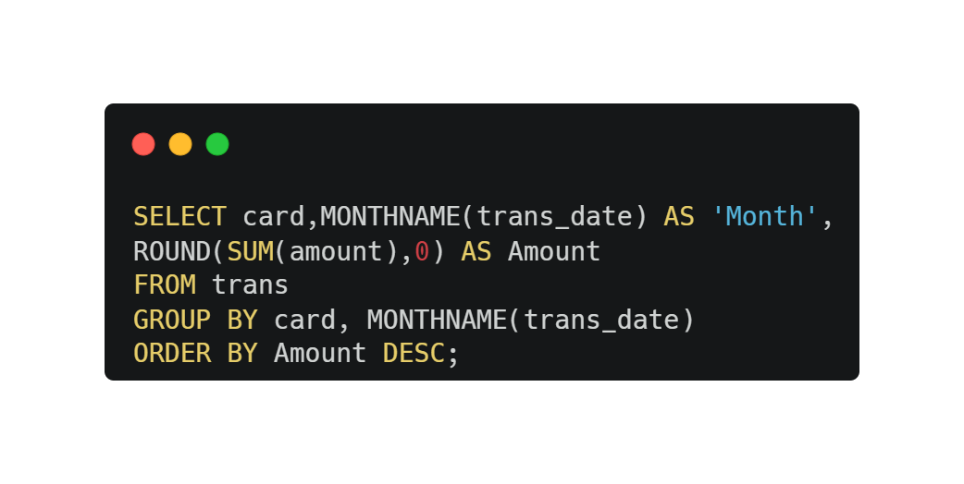
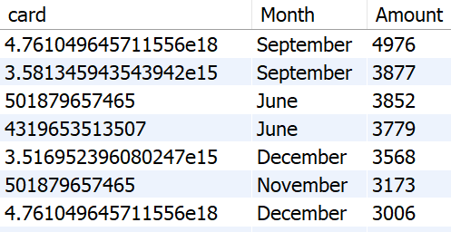
For each card, calculate the total transaction amount for each month.
01

Slide 2
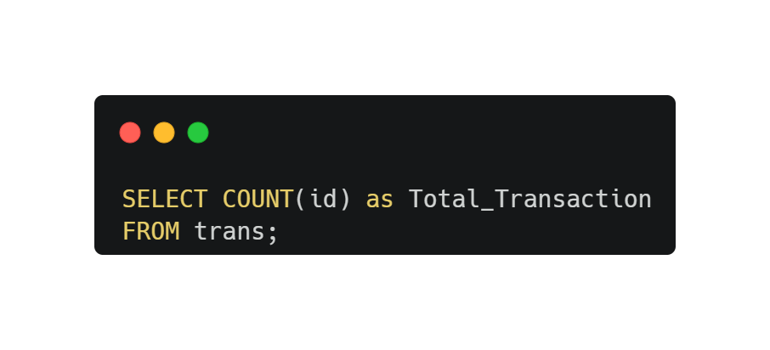

What is the total number of transactions in the dataset?
02

Slide 3
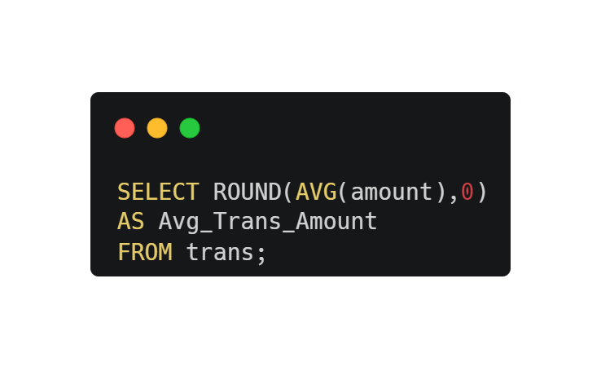

What is the average transaction amount?
03

Slide 4
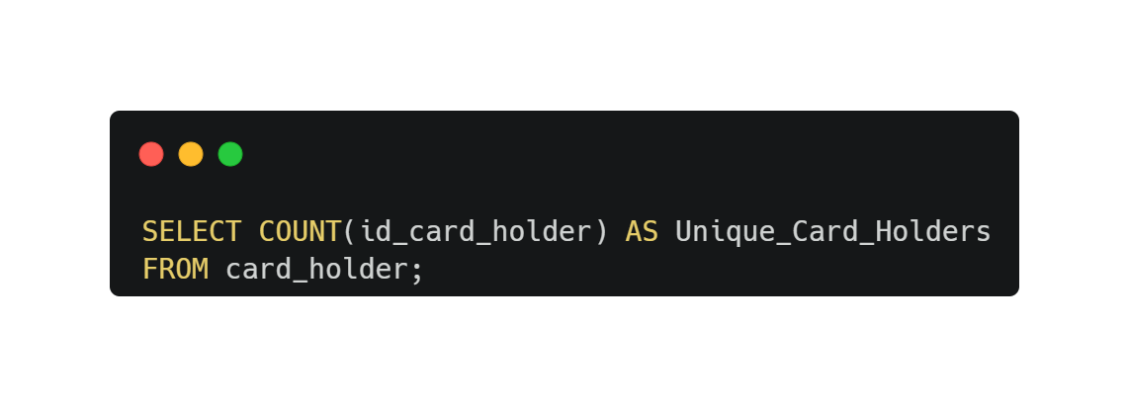

How many unique card holders are there in the dataset?
04

Slide 5
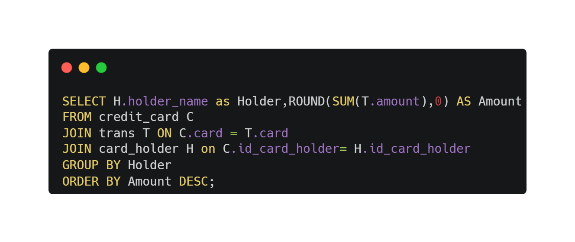
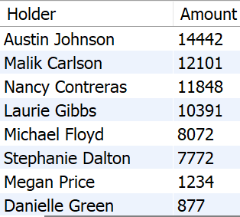
What is the total amount spent by each card holder?
05

Slide 6
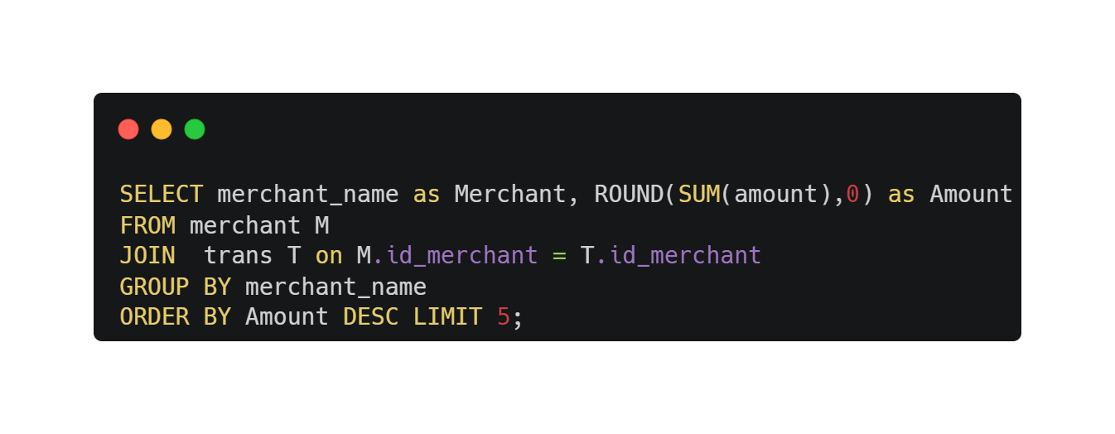
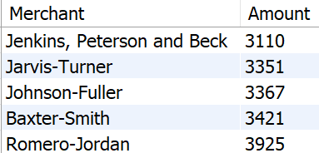
Identify the top 5 merchants with the highest transaction amounts.
06

Slide 7
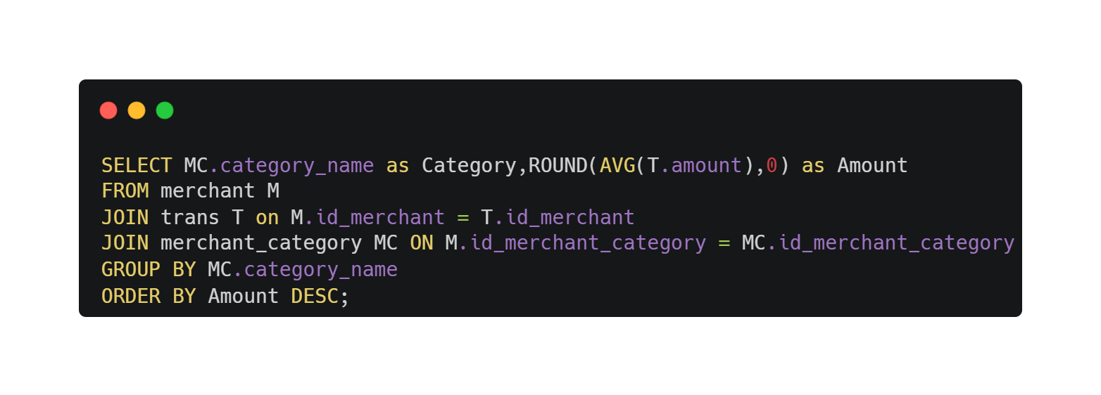
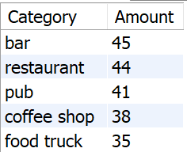
What is the average transaction amount for each merchant category?
07

Slide 8
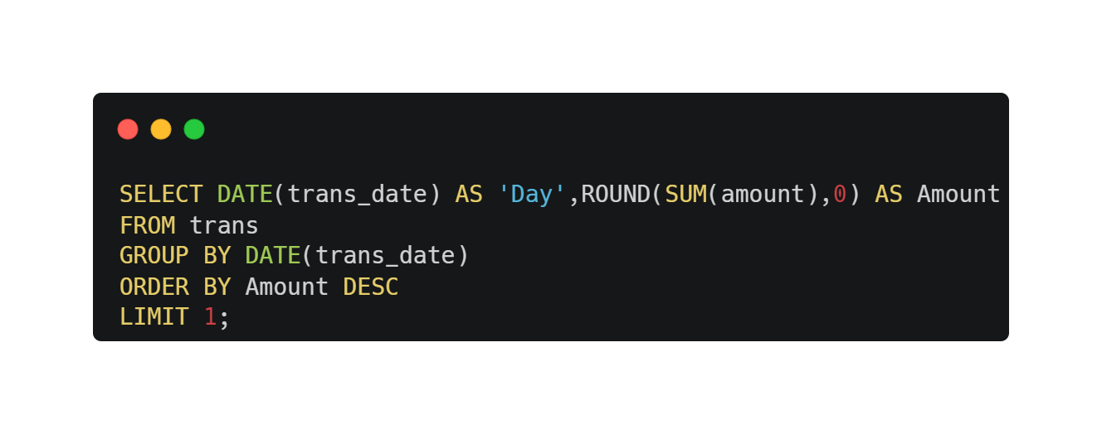

Find the day with the highest total transaction amount.
08

Slide 9
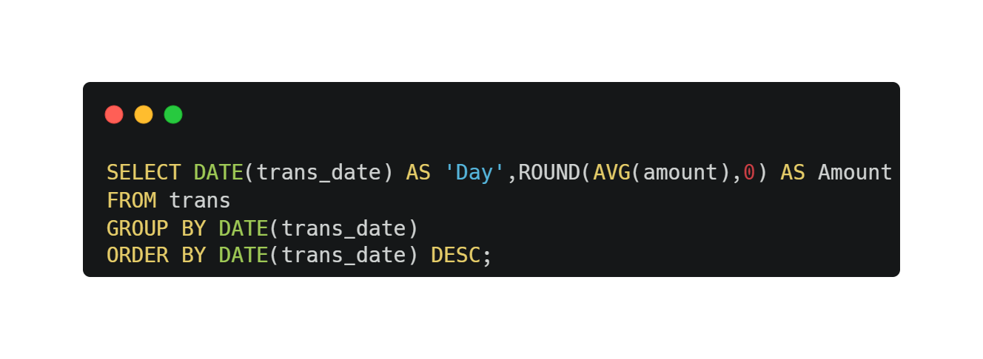
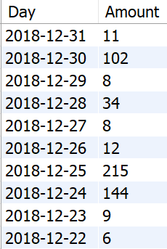
Calculate the average transaction amount per day.
09

Slide 10
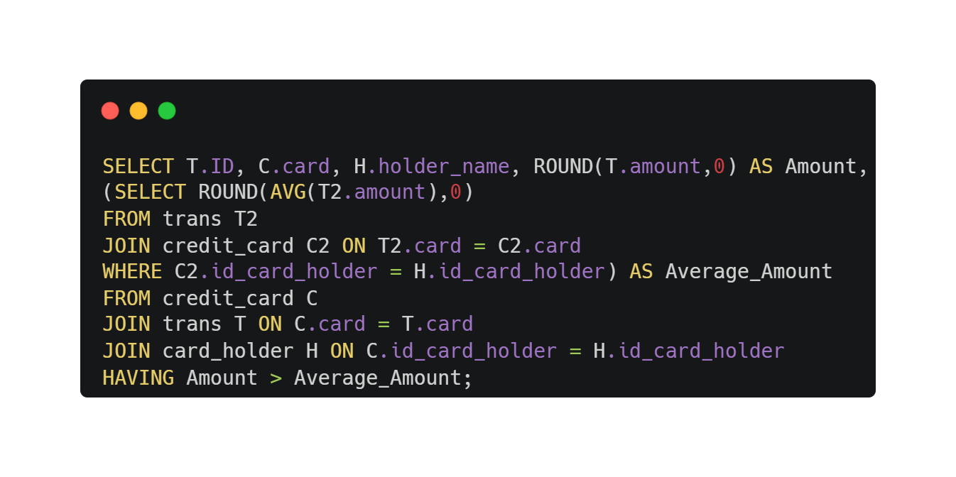
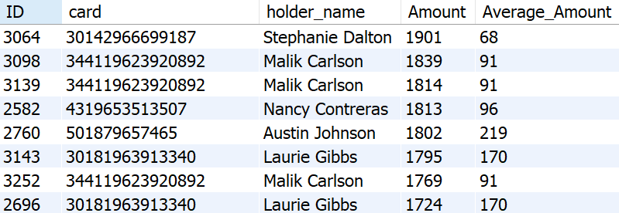
Identify transactions where the amount is significantly higher than the average amount for that card holder
10

Slide 11
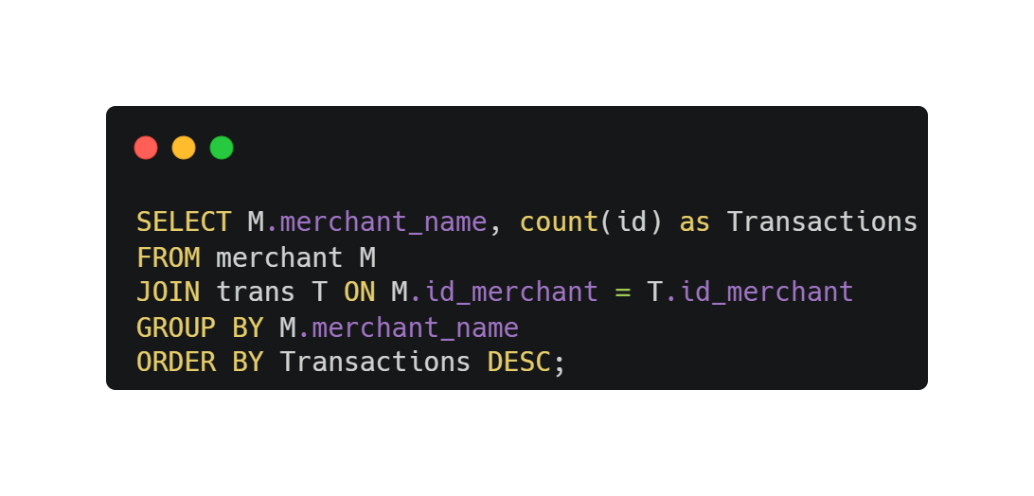
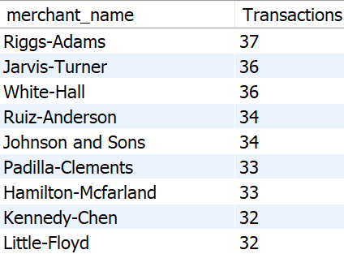
Identify merchants with the highest number of transactions.
11

Slide 12
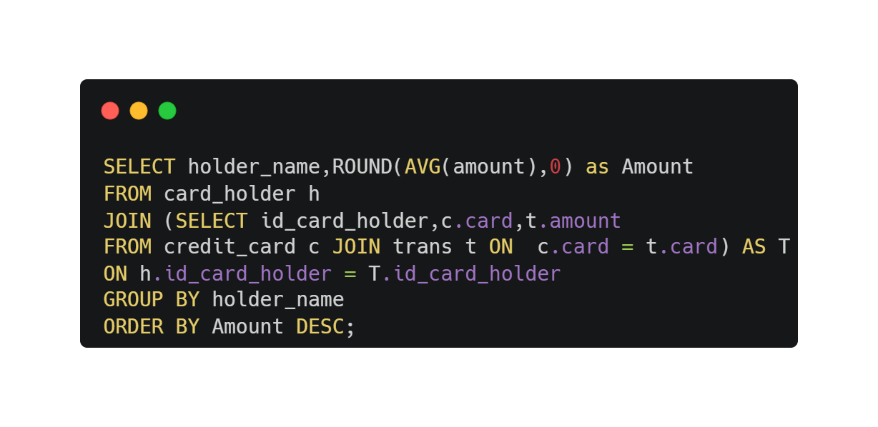
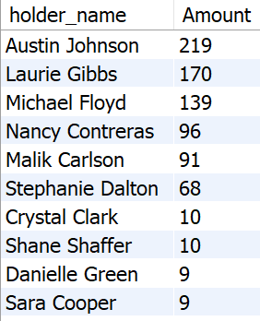
Calculate the average transaction amount for each card holder's name.
12

Slide 13

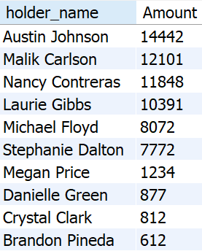
Find the top 10 card holders with the highest total transaction amounts.
13

Slide 14
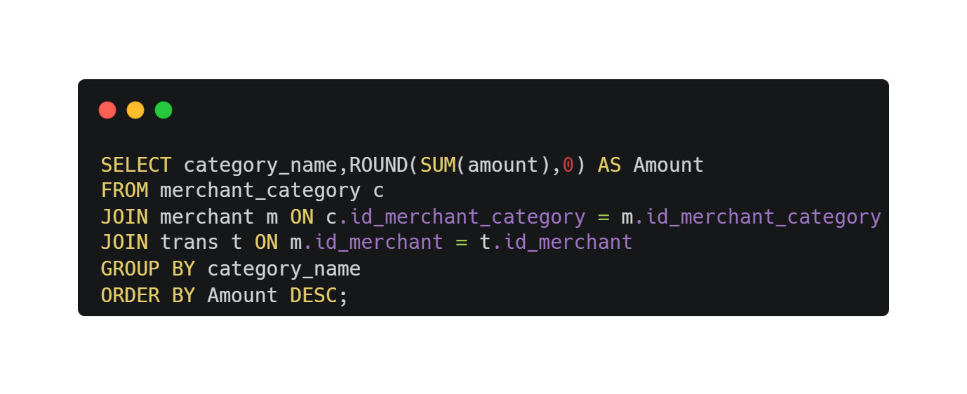
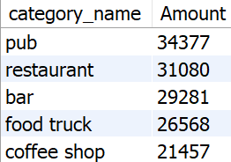
Find the merchant categories with the highest total transaction amounts.
14

